Slide 1


Example 1.1 Law of Definite Proportions
Two samples of carbon dioxide decompose into their constituent elements. One sample produces 25.6 g of oxygen and 9.60 g of carbon, and the other produces 21.6 g of oxygen and 8.10 g of carbon. Show that these results are consistent with the law of definite proportions.
Solution
To show this, calculate the mass ratio of one element to the other for both samples by dividing the mass of one element by the mass of the other. For convenience, divide the larger mass by the smaller one.
For the first sample:
For the second sample:
The ratios are the same for the two samples, so these results are consistent with the law of definite proportions.
For Practice 1.1
Two samples of carbon monoxide decompose into their constituent elements. One sample produces 17.2 g of oxygen and 12.9 g of carbon, and the other sample produces 10.5 g of oxygen and 7.88 g of carbon. Show that these results are consistent with the law of definite proportions.

Slide 2
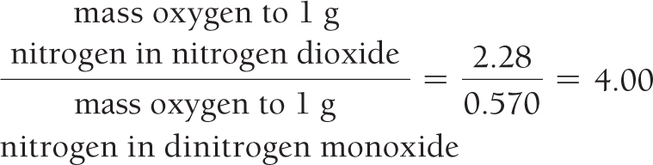
Example 1.2 Law of Multiple Proportions
Nitrogen forms several compounds with oxygen, including nitrogen dioxide and dinitrogen monoxide. Measurements of the masses of nitrogen and oxygen that form upon decomposing these compounds show that nitrogen dioxide contains 2.28 g oxygen to every 1.00 g nitrogen, while dinitrogen monoxide contains 0.570 g oxygen to every 1.00 g nitrogen. Show that these results are consistent with the law of multiple proportions.
Solution
To show this, calculate the ratio of the mass of oxygen from one compound to the mass of oxygen in the other. Always divide the larger of the two masses by the smaller one.
The ratio is a small whole number (4); these results are consistent with the law of multiple proportions.
For Practice 1.2
Hydrogen and oxygen form both water and hydrogen peroxide. The decomposition of a sample of water forms 0.125 g hydrogen to every 1.00 g oxygen. The decomposition of a sample of hydrogen peroxide forms 0.0625 g hydrogen to every 1.00 g oxygen. Show that these results are consistent with the law of multiple proportions.

Slide 3



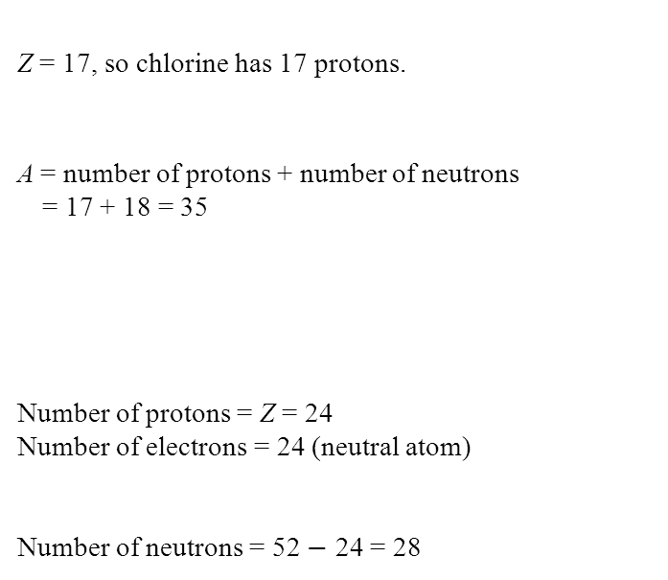
Example 1.3 Atomic Numbers, Mass Numbers, and Isotope Symbols
a. What are the atomic number (Z), mass number (A), and symbol of the chlorine isotope with 18 neutrons?
b. How many protons, electrons, and neutrons are present in an atom of ?
Solution
a. Look up the atomic number (Z) for chlorine on the periodic table. The atomic number specifies the number of protons.
The mass number (A) for an isotope is the sum of the number of protons and the number of neutrons.
The symbol for an isotope is its two-letter abbreviation with the atomic number (Z) in the lower left corner and
the mass number (A) in the upper left corner.
b. For any isotope (in this case ), the number of protons is indicated by the atomic number located at the lower left. Since this is a neutral atom, the number of electrons equals the number of protons.
The number of neutrons is equal to the mass number (upper left) minus the atomic number (lower left).
Z = 17, so chlorine has 17 protons.
A = number of protons + number of neutrons
= 17 + 18 = 35
Number of protons = Z = 24
Number of electrons = 24 (neutral atom)
Number of neutrons = 52 $−$ 24 = 28

Slide 4

Example 1.3 Atomic Numbers, Mass Numbers, and Isotope Symbols
Continued
For Practice 1.3
a. What are the atomic number, mass number, and symbol for the carbon isotope with 7 neutrons?
b. How many protons and neutrons are present in an atom of ?

Slide 5
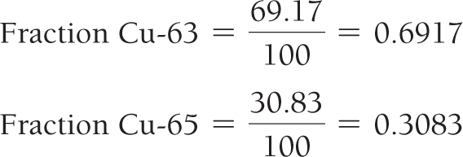
Example 1.4 Atomic Mass
Copper has two naturally occurring isotopes: Cu-63 with mass 62.9396 amu and a natural abundance of 69.17%,
and Cu-65 with mass 64.9278 amu and a natural abundance of 30.83%. Calculate the atomic mass of copper.
Solution
Convert the percent natural abundances into decimal form by dividing by 100.
Calculate the atomic mass using the equation given
in the text. (See Section E.4 for significant figure and rounding conventions.)
The magnitude of the answer makes sense given that approximately two-thirds of the atoms have a mass of nearly 63 amu and one-third have a mass of nearly 65.
The weighted average should be closer to 63 than 65.
For Practice 1.4
Magnesium has three naturally occurring isotopes with masses of 23.99 amu, 24.99 amu, and 25.98 amu and natural abundances of 78.99%, 10.00%, and 11.01%, respectively. Calculate the atomic mass of magnesium.
For More Practice 1.4
Gallium has two naturally occurring isotopes: Ga-69 with a mass of 68.9256 amu and a natural abundance of 60.11%, and Ga-71. Use the atomic mass of gallium from the periodic table to find the mass of Ga-71.

Slide 6
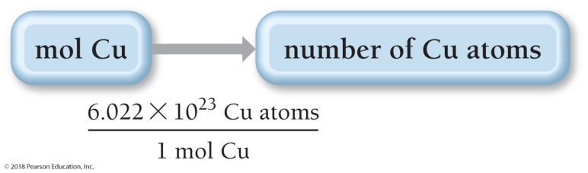
Example 1.5 Converting between Number of Moles and Number of Atoms
Calculate the number of copper atoms in 2.45 mol of copper.
SORT You are given the amount of copper in moles and asked to find the number of copper atoms.
GIVEN 2.45 mol Cu
FIND Cu atoms
STRATEGIZE Convert between number of moles and number of atoms using Avogadro’s number as a
conversion factor.
CONCEPTUAL PLAN
RELATIONSHIPS USED
6.022 ×10²³ = 1 mol (Avogadro’s number)
SOLVE Follow the conceptual plan to solve the problem. Begin with 2.45 mol Cu and multiply by Avogadro’s number to get to the number of Cu atoms.

Slide 7
Example 1.5 Converting between Number of Moles and Number of Atoms
Continued
SOLUTION
CHECK Since atoms are small, it makes sense that the answer is large. The given number of moles of copper is almost 2.5, so the number of atoms is almost 2.5 times Avogadro’s number.
For Practice 1.5
A pure silver ring contains 2.80 × 10²² silver atoms. How many moles of silver atoms does it contain?

Slide 8
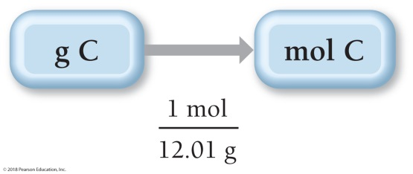
Example 1.6 Converting between Mass and Amount (Number of Moles)
Calculate the amount of carbon (in moles) contained in a 0.0265-g pencil “lead.” (Assume that the pencil “lead” is made of pure graphite, a form of carbon.)
SORT You are given the mass of carbon and asked to find the amount of carbon in moles.
GIVEN 0.0265 g C
FIND mol C
STRATEGIZE Convert between mass and amount (in moles) of an element using the molar mass of the element.
CONCEPTUAL PLAN
RELATIONSHIPS USED
12.01 g C = 1 mol C (carbon molar mass)
SOLVE Follow the conceptual plan to solve the problem.

Slide 9

Example 1.6 Converting between Mass and Amount (Number of Moles)
Continued
SOLUTION
CHECK The given mass of carbon is much less than the molar mass of carbon, so it makes sense that the answer (the amount in moles) is much less than 1 mol of carbon.
For Practice 1.6
Calculate the amount of copper (in moles) in a 35.8-g pure copper sheet.
For More Practice 1.6
Calculate the mass (in grams) of 0.473 mol of titanium.

Slide 10
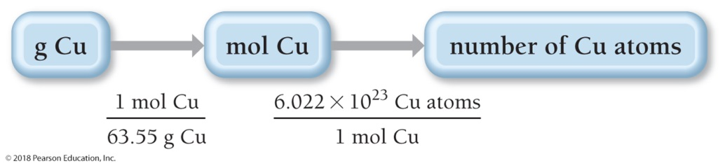
Example 1.7 The Mole Concept—Converting between Mass and Number of Atoms
How many copper atoms are in a copper penny with a mass of 3.10 g? (Assume that the penny is composed of
pure copper.)
SORT You are given the mass of copper and asked to find the number of copper atoms.
GIVEN 3.10 g Cu
FIND Cu atoms
STRATEGIZE Convert between the mass of an element in grams and the number of atoms of the element by first converting to moles (using the molar mass of the element) and then to number of atoms (using Avogadro’s number).
CONCEPTUAL PLAN
RELATIONSHIPS USED
63.55 g Cu = 1 mol Cu (molar mass of copper)
6.022 × 10²³ = 1 mol (Avogadro’s number)

Slide 11
Example 1.7 The Mole Concept—Converting between Mass and Number of Atoms
Continued
SOLVE Follow the conceptual plan to solve the problem. Begin with 3.10 g Cu and multiply by the appropriate conversion factors to arrive at the number of Cu atoms.
SOLUTION
CHECK The answer (the number of copper atoms) is less than 6.022 × 10²³ (one mole). This is consistent with the given mass of copper atoms, which is less than the molar mass of copper.
For Practice 1.7
How many carbon atoms are there in a 1.3-carat diamond? Diamonds are a form of pure carbon. (1 carat = 0.20 g)
For More Practice 1.7
Calculate the mass of 2.25 × 10²² tungsten atoms.

Slide 12
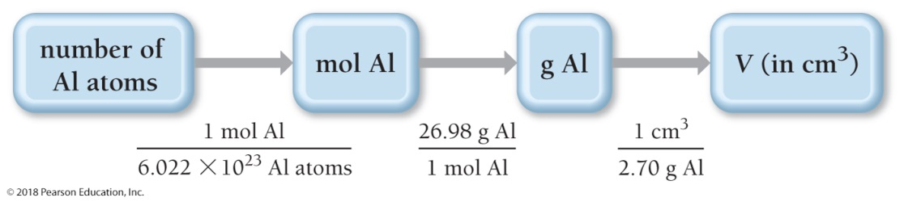
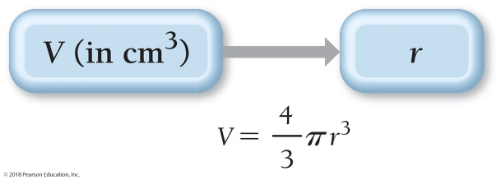
Example 1.8 The Mole Concept
An aluminum sphere contains 8.55 × 10²² aluminum atoms. What is the sphere’s radius in centimeters? The density of aluminum is 2.70 g/cm³.
SORT You are given the number of aluminum atoms in a sphere and the density of aluminum. You are asked to find the radius of the sphere.
GIVEN 8.55 × 10²² Al atoms
d = 2.70 g/cm³
FIND radius (r) of sphere
STRATEGIZE The heart of this problem is density, which relates mass to volume, and though you aren’t given the mass directly, you are given the number of atoms, which you can use to find mass.
Convert from number of atoms to number of moles using Avogadro’s number as a conversion factor.
Convert from number of moles to mass using molar mass as a conversion factor.
Convert from mass to volume (in cm3) using density as a conversion factor.
Once you calculate the volume, find the radius from the volume using the formula for the volume of a sphere.
CONCEPTUAL PLAN

Slide 13
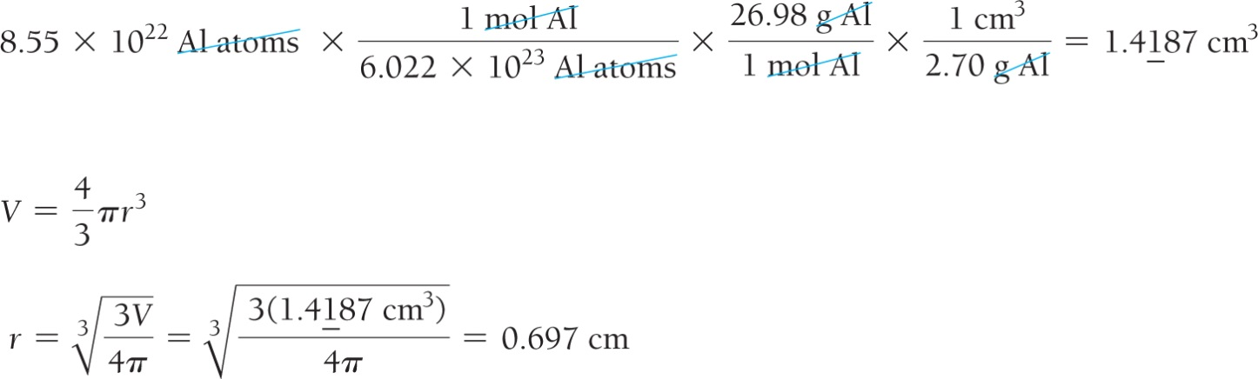
Example 1.8 The Mole Concept
Continued
RELATIONSHIPS AND EQUATIONS USED
6.022 × 10²³ = 1 mol (Avogadro’s number)
26.98 g Al = 1 mol Al (molar mass of aluminum)
2.70 g/cm³ (density of aluminum)
V = πr³ (volume of sphere)
SOLVE Finally, follow the conceptual plan to solve the problem. Begin with 8.55 × 10²² Al atoms and multiply by the appropriate conversion factors to arrive at volume in cm³.
Then solve the equation for the volume of a sphere for r and substitute the volume to calculate r.
SOLUTION

Slide 14
Example 1.8 The Mole Concept
Continued
CHECK The units of the answer (cm) are correct. The magnitude cannot be estimated accurately, but a radius of about one-half of a centimeter is reasonable for just over one-tenth of a mole of aluminum atoms.
For Practice 1.8
A titanium cube contains 2.86 × 10²³ atoms. What is the edge length of the cube? The density of titanium is
4.50 g/cm³.
For More Practice 1.8
Find the number of atoms in a copper rod with a length of 9.85 cm and a radius of 1.05 cm. The density of copper is 8.96 g/cm³.

